Slide 1


Slide 2
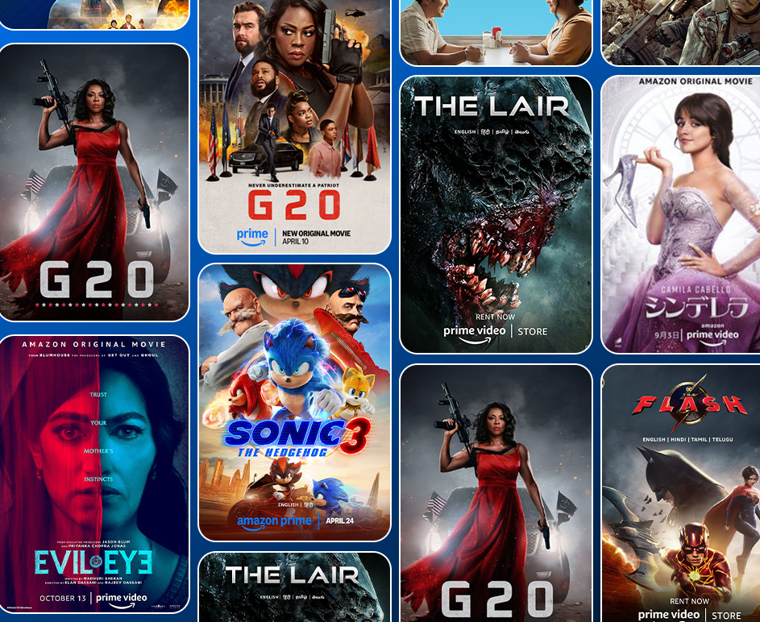

EDA : Amazon Prime TV Shows & Movies
Uncovering insights to guide content strategy, marketing, and investment decisions

Slide 3



📽️Introduction
This project explores Amazon Prime Video's US catalog using Exploratory Data Analysis (EDA).
The goal is to uncover trends in genres, content type, release years, ratings, and popularity.
We use this analysis to provide actionable insights for: * 🎯 Content strategists * 📣 Marketing teams * 💰 Investors

Slide 4

📋 Table of Contents
Project Objective & Dataset Overview
Data Cleaning & Preparation
Visual Exploratory Data Analysis
🟠 Plot 1: Content Type Distribution
🎭 Plot 2: Top 10 Genres
🌟 Plot 3: IMDb Score Distribution
📈 Plot 4: Titles Over the Years
🔞 Plot 5: Age Certification
🔥 Plot 6: Most Popular Titles (TMDb)
🌍 Plot 7: Top Content-Producing Countries
⭐ Plot 8: Top Genres by IMDb Score
🎭 Top 10 Actors by IMDb Score
🎬 Top 10 Directors by IMDb Score
Strategic Business Insights
Summary & Conclusion

Slide 5

🎯Project Objective
Explore content trends on Amazon Prime (US)
Identify high-performing genres, quality gaps, and content distribution
Provide actionable insights for strategists, marketers, and investors

Slide 6
📂 Dataset Overview
Files Used:
titles.csv – Title metadata (9k+ titles)
credits.csv – Actor/Director data (124k+ rows)

Slide 7
🧹 Data Cleaning & Preparation
We performed data type corrections, handled missing values, and cleaned structured fields to ensure consistent analysis.

Slide 8
✅ Steps Taken for cleaning:
Converted stringified lists in genres and production_countries using ast.literal_eval
Removed duplicates and unnecessary columns
Fixed null/missing values in imdb_score, runtime, and age_certification
Converted column types where required (e.g., release_year to int)
Checked and handled outliers in numeric columns

Slide 9
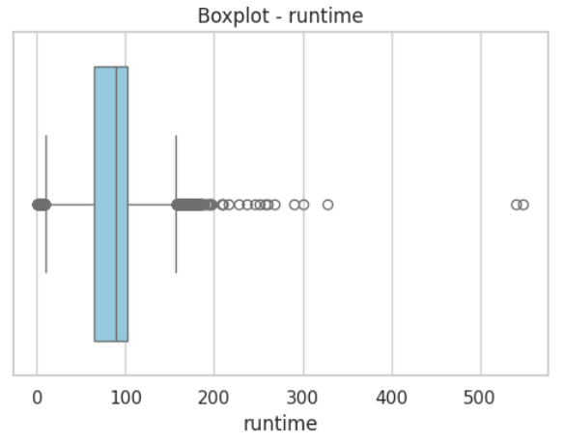
📊 Outlier Handling
To ensure the numeric values (e.g., runtime, ratings, votes, popularity) are within a valid and meaningful range, we performed outlier detection using the Interquartile Range (IQR) method. Outliers beyond 1.5 * IQR from Q1 or Q3 were removed to avoid skewing analysis.

Slide 10
📊 Visual Exploratory Data Analysis

Slide 11

🟠 Plot 1: Content Type Distribution
Insight: Movies dominate the Amazon Prime US catalog, accounting for ~89% of the content, while TV shows make up only ~11%. This highlights a strategic bias toward single-sitting content. However, TV series often lead to stronger binge behavior and user retention, an area that appears underutilized.

Slide 12
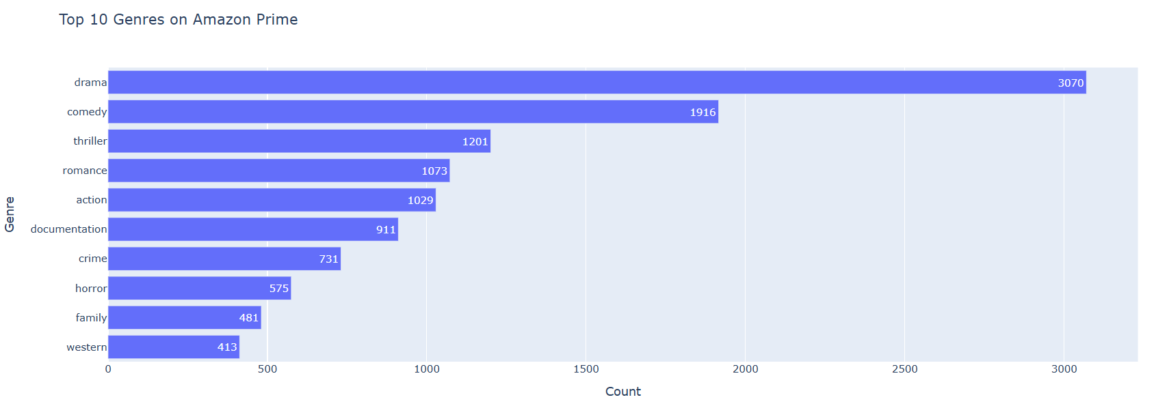
🎭 Plot 2: Top 10 Genres on Amazon Prime
Insight: Drama, Comedy, and Thriller are the most represented genres. While these drive broad appeal, their overrepresentation may lead to content saturation. Underrepresented but emerging genres (like Music, Animation, and War) could help diversify the viewer experience.

Slide 13
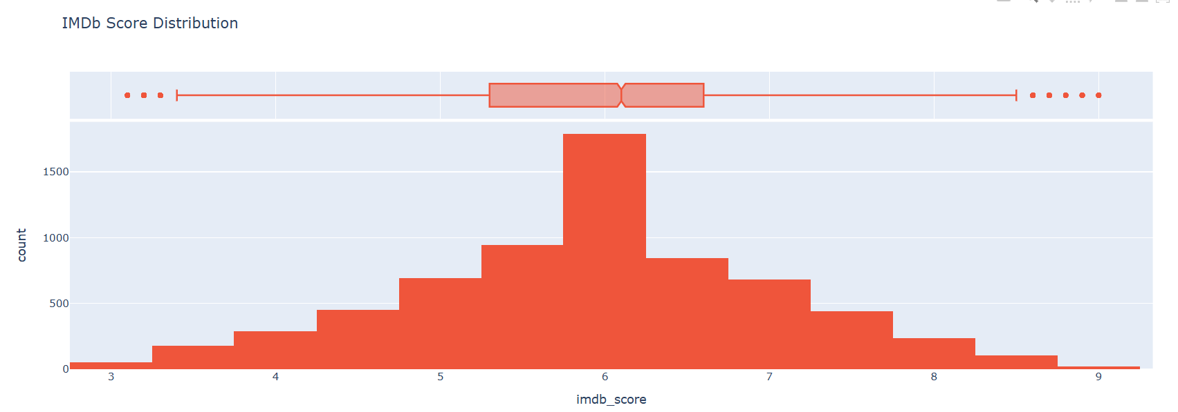
🌟 Plot 3: IMDb Score Distribution
Insight: The majority of titles have IMDb scores between 5.3 to 6.6, indicating average audience reception. This suggests an opportunity to invest more in quality control or content refinement. Very few titles cross the 8+ threshold, limiting the platform's critically acclaimed appeal.

Slide 14
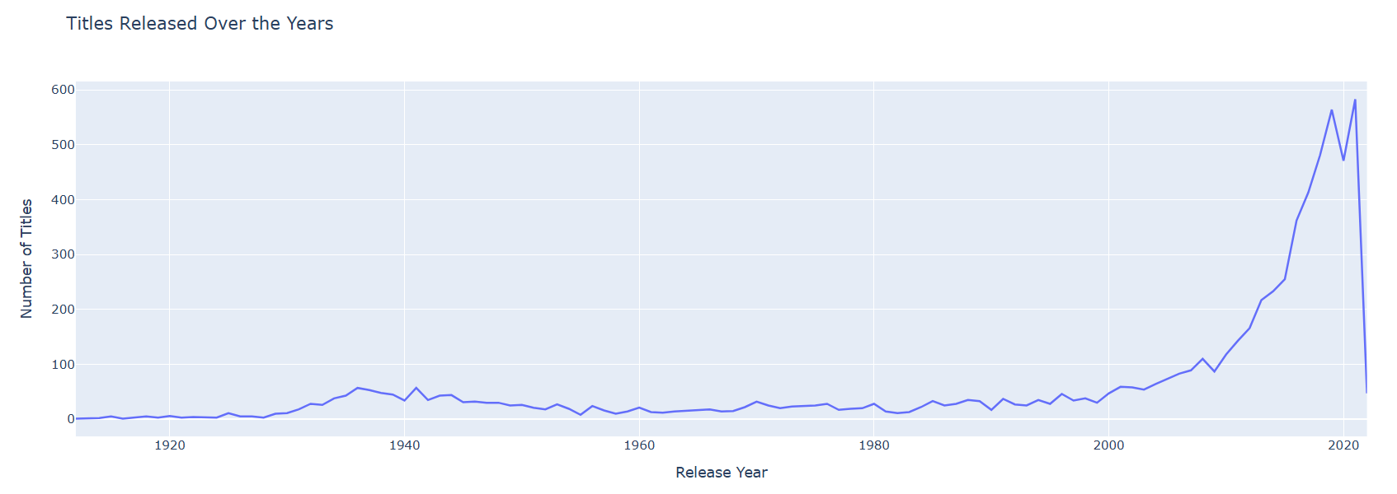
📈 Plot 4: Titles Released Over the Years
Insight: There was a steep rise in content additions post-2015, peaking around 2021, likely due to Prime’s expansion strategy. A notable dip in 2022 may reflect reduced acquisition, pandemic production delays, or changes in business focus, indicating potential room for renew

Slide 15
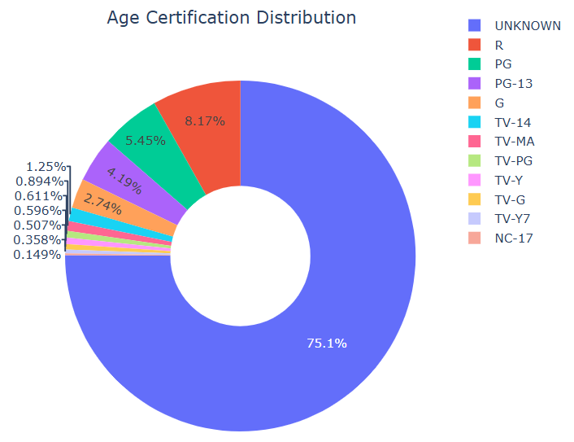
🔞 Plot 5: Age Certification Distribution
Insight: Over 5,000 titles are marked 'Unknown' in age certification, nearly half the catalog. This suggests poor metadata hygiene, potentially affecting user safety, parental control features, and recommendation accuracy. Cleaning this up could improve both UX and compliance.

Slide 16
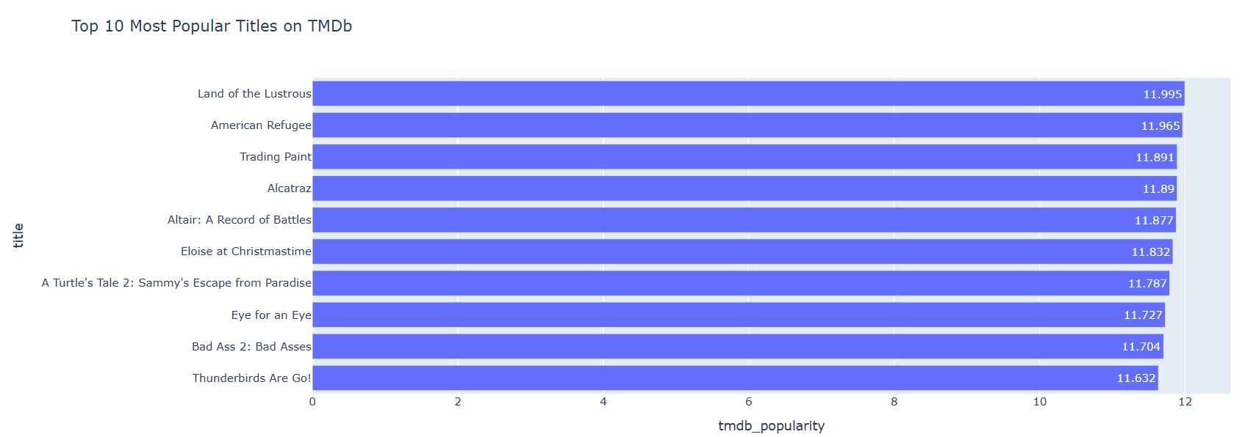
🔥 Plot 6: Top 10 Most Popular Titles (TMDb Popularity
Insight: Titles with the highest TMDb popularity scores don’t always have high IMDb ratings. This mismatch suggests that trending titles may drive views but not always satisfaction. There's an opportunity to push top-rated but underexposed content into trending spots.

Slide 17
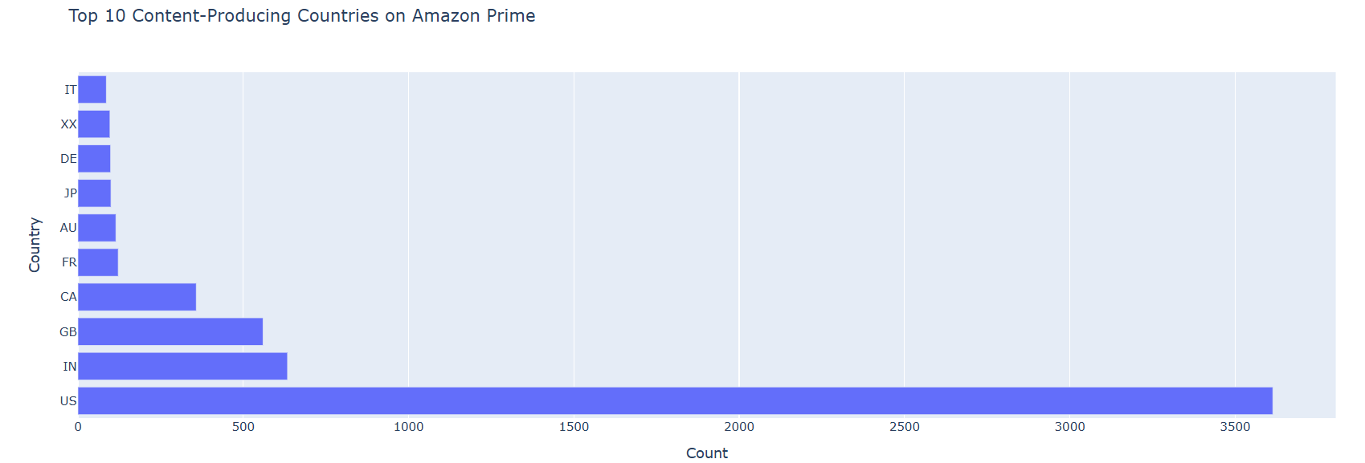
🌍 Plot 7: Top Content-Producing Countries
Insight: The US is the largest contributor by far, followed by the India, UK and Canada. While this aligns with Prime’s core markets, the catalog shows a lack of regional diversity from areas like Latin America, Africa, and Southeast Asia, a missed opportunity to attract global audiences.

Slide 18
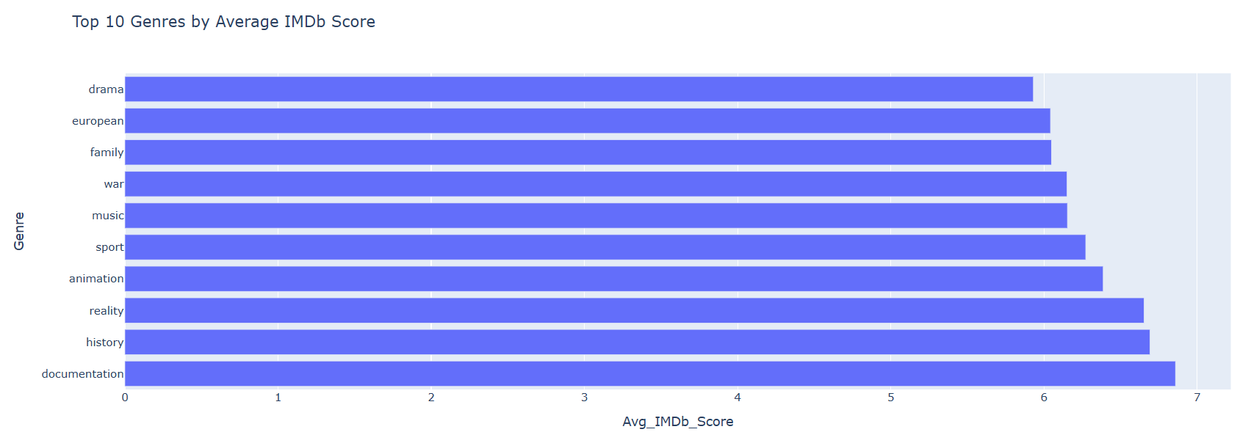
⭐ Plot 8: Top Genres by IMDb Rating
Insight: Documentation, History, and Reality genres have the highest average IMDb scores, despite being lower in volume. This signals untapped potential — investing in these genres can raise the platform’s perceived quality and attract more serious or niche viewers.

Slide 19
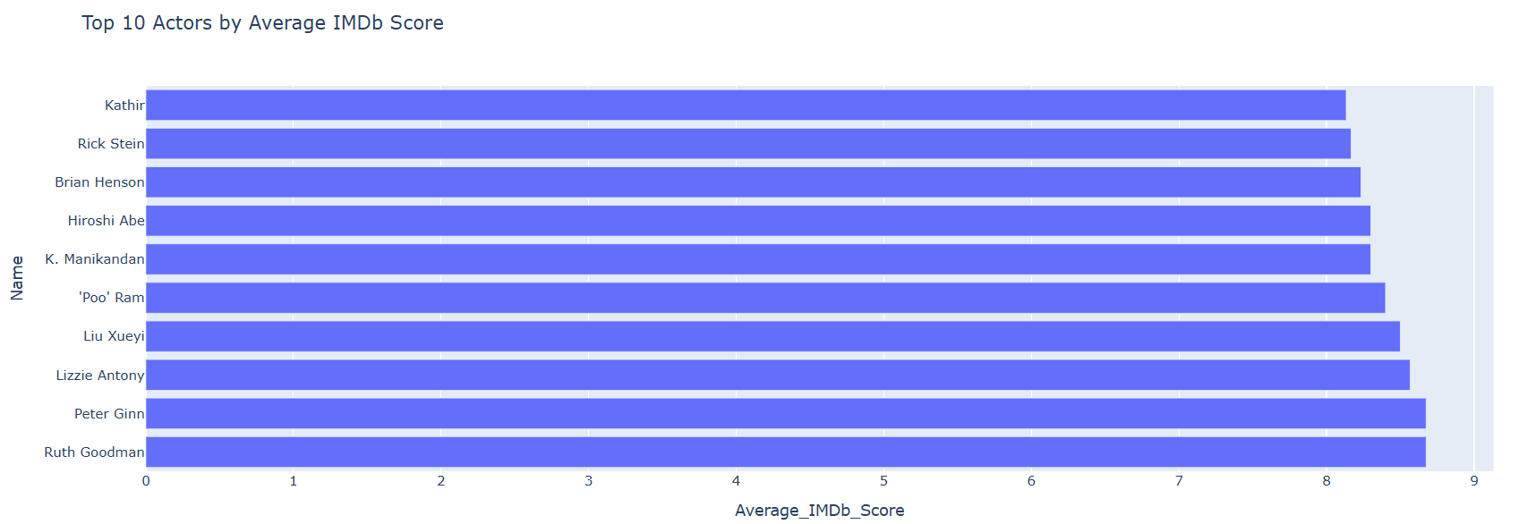
🎭 Plot 9: Top 10 Actors by Average IMDb Score
Insight: A select group of actors consistently appear in highly rated titles. Their involvement may positively influence audience perception and ratings. These actors can be prioritized for casting in new original content or featured in targeted marketing campaigns.

Slide 20
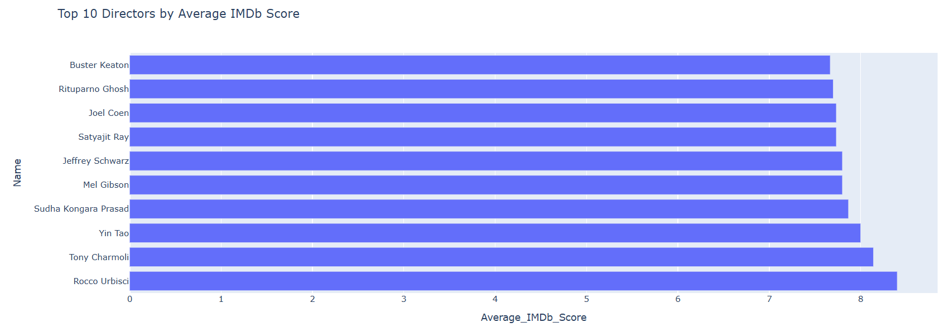
🎬 Plot 10: Top 10 Directors by Average IMDb Score
Insight: Directors with 3+ titles and high average ratings are rare but valuable. Their track records indicate an ability to consistently produce quality content. These creators can be prioritized for future collaborations or exclusive content development.

Slide 21
✅ Slide 15: Summary & Conclusion
Summary of Key Insights:
🟠 Content Type Bias: Amazon Prime leans heavily toward movies (89%), potentially under-leveraging TV shows for user retention.
🎭 Genre Trends: While Drama and Comedy dominate in quantity, Documentation, History, and Reality genres outperform in IMDb ratings, highlighting a gap between content volume and content quality.
🌍 Geographic Skew: The US, UK, and Canada produce most of the content. There's minimal presence from Asia, Latin America, or Africa — showing an untapped opportunity to globalize the library.

Slide 22
✅ Summary & Conclusion
🔞 Metadata Gaps: Over 5,000 titles lack age certification, which may weaken search filters, recommendation systems, and compliance with regional content laws.
🌟 Disjoint in Ratings vs. Popularity: TMDb popularity scores don’t always match IMDb ratings. This misalignment shows that trending titles may not always be high-quality, and quality content might not be well-promoted.
🎭 & 🎬 Creator Influence: A small subset of actors and directors consistently appear in highly-rated titles, revealing key talent that can elevate future content.

Slide 23
🎯Strategic Business Impact
📺 For Content Strategists:
Rebalance content mix by investing more in TV shows to drive higher session duration and viewer stickiness.
Capitalize on high-performing but underproduced genres like Documentation, History, and Reality to capture niche audiences.
Leverage creator intelligence (top actors/directors) to maintain high content quality standards.
Localize production by expanding into non-Western regions for a broader international appeal.

Slide 24
🎯Strategic Business Impact
📣 For Marketing Teams:
Create campaigns around hidden gems , high IMDb-rated titles that are not trending but offer great storytelling.
Highlight top genres by ratings (not just by count) in promotional banners.
Feature well-rated titles starring top-rated actors and directors to build credibility and viewer trust.

Slide 25
🎯Strategic Business Impact
💰 For Investors:
Focus investments on genres and creators that have proven audience approval (via IMDb scores).
The 2022 drop in content offers a timely opportunity to fund new, exclusive titles and regain growth momentum.
Align funding with region and genre diversification to reduce catalog redundancy and improve risk management.

